Slide 1
Digital Portfolio
STUDENT NAME: KOSAL RAJ.V
REGISTER NO AND NMID: autunm11024ca108
DEPARTMENT: BCA
COLLEGE: DRBCCC.HINDU COLLEGE

Slide 2
PROJECT TITLE
PORTFOLIO WEBSITE

Slide 3


AGENDA
Problem Statement
Project Overview
End Users
Tools and Technologies
Portfolio design and Layout
Features and Functionality
Results and Screenshots
Conclusion
Github Link
3/21/2024 Annual Review

Slide 4

PROBLEM STATEMENT
It is not enough to just know how to do things in today's job market. Clients and recruiters often look for a strong professional presence that shows off skills, previous work, and personal branding. A lot of developers have trouble showing off their work in a way that is both organized and interesting. This project solves that problem by making a personal portfolio website that is both visually appealing and professionally informative. This lets potential employers or collaborators quickly see the developer's skills and knowledge.

Slide 5

PROJECT OVERVIEW
This project is a website for my personal portfolio that showcases my accomplishments, projects, and abilities. The portfolio offers a methodical approach to showcasing my identity, activities, and contact details. It is modern, interactive, and completely responsive, guaranteeing device accessibility.

Slide 6

WHO ARE THE END USERS?
Students – who want to showcase academic achievements, projects, and skills.
Recruiters/Employers – To evaluate skills and experience.
Clients – who may want to hire me for freelancing projects.
Peers/Collaborators – who are interested in networking and team projects

Slide 7

TOOLS AND TECHNIQUES
Tools and Technologies
Frontend: HTML, CSS, JavaScript
Hosting: GitHub Pages

Slide 8
POTFOLIO DESIGN AND LAYOUT
Header + Navigation (sticky navbar).
Home Section: intro + profile image + typing effect.
About Section: short bio, career goals.
Skills Section: grid-based skill cards.
Projects Section: cards with hover effects.
Contact Section: contact form + social icons.
Footer: social media links (GitHub, LinkedIn, LeetCode, Twitter).
8

Slide 9
FEATURES AND FUNCTIONALITY
Responsive design (works on desktop, tablet, and mobile).
Animated typing effect for roles.
Interactive hover effects on skills and projects.
Contact form with validation.
Social media icons with links (GitHub, LinkedIn, Email).
Smooth scrolling navigation.

Slide 10
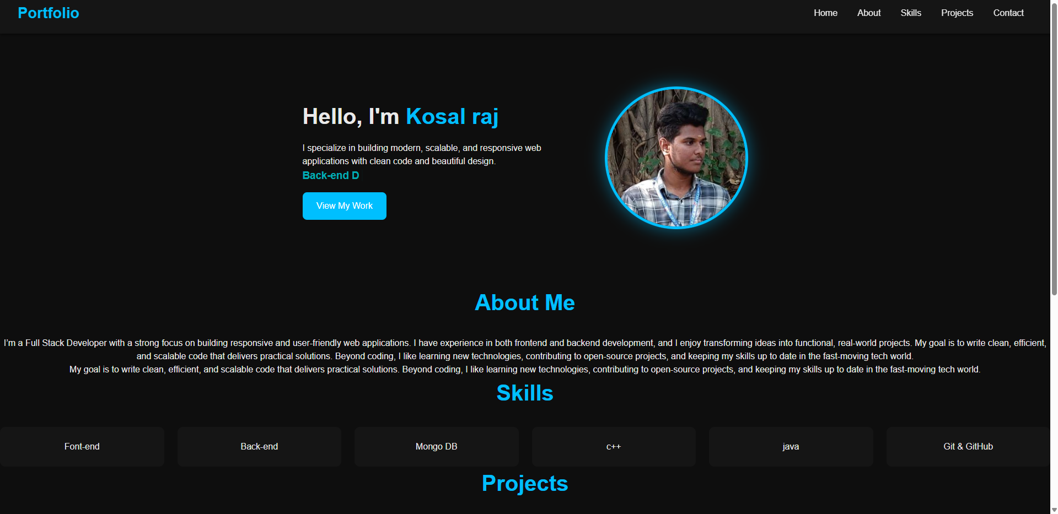

RESULTS AND SCREENSHOTS
3/21/2024 Annual Review
10

Slide 11
CONCLUSION
Theportfolio effectively presents personal branding.
Enhances chances of job opportunities and collaborations.
Easily maintainable and extendable.
11

Slide 12
Github Link
https://github.com/kosalraj2007/TNSDC-FWD-DP.git

